Slide 1
Bitcoin EMA
Margin trade Strategy
Group 3
Li li
Siqi Yi
Yutao Liang

Slide 2
1
Purpose and main idea
Content
2
Specific methods and steps
3
Final result

Slide 3
PART ONE
Purpose and main idea

Slide 4
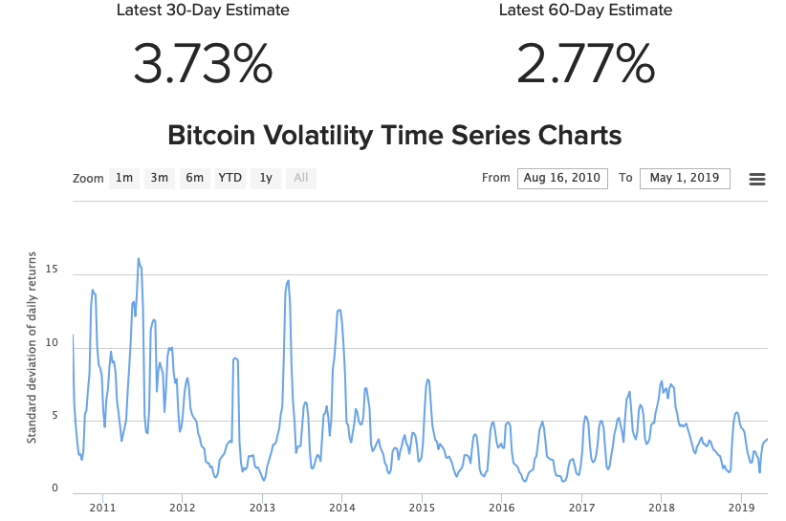
Purpose
01

Slide 5
Purpose
01
Bitcoin‘s price volatility is great.
Returns of time the market is large.
Short at high price, long at low price.

Slide 6
Main idea
01
15%
55%
100%
Simulate trade-related cost
Build EMA Margin Trade Strategy
Optimise the Strategy and Select the Best Strategy

Slide 7
Main idea
01
First
We use Volume Weighted Average Price(VWAP) trading strategy to simulate the trade-related cost.
The evaluation indicators include the pecentage of trade-related cost.

Slide 8
Main idea
Second
01
Analyse the difference between Bitcoin price and Exponential Moving Average(EMA) price to find the boundary of abnormal high and abnormal low price. Short in abnormal high price and long in abnormal low price.
The calculated indicators of the model include:
ema
diff_pct_close_vs_ema
diff_pct_close_vs_ema_negative_abnormal
diff_pct_close_vs_ema_positive_abnormal

Slide 9
Main idea
01
Third
Select multiple span of EMA, execute the strategy many times. Find the optimised stragegy that has the maxmum sharpe ratio and high winning rate.
The evaluation indicators of the model include:
winning rate
annual return
annual standard deviation
annual sharpe ratio

Slide 10
PART TWO
Specific methods and steps

Slide 11
02
Specific methods and steps
1.Simulate trade-related cost
Download Bitcoin market chart and trade history data
Build Polynomial Linear Model with train data
Calculate the Percentage of Trade-related Cost
Trade with Model
Download Data
Process Data
Build Model
Calculate Cost
Index, fill, split, randomly select start time. Train and test data.
Trade with the Model and test data

Slide 12
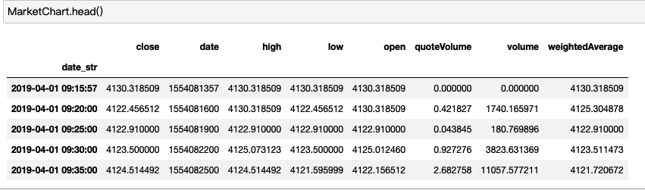
02
Specific methods and steps
Download Data

Slide 13
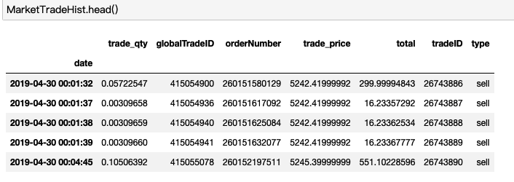
02
Specific methods and steps
Download Data

Slide 14
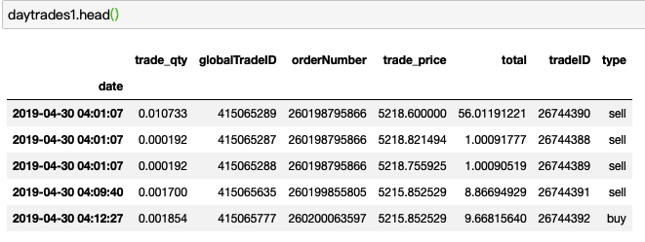
02
Specific methods and steps
Process Data

Slide 15
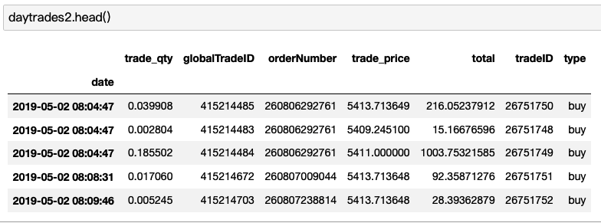
02
Specific methods and steps
Process Data

Slide 16
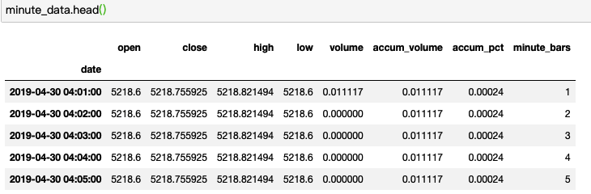
02
Specific methods and steps
Process Data

Slide 17
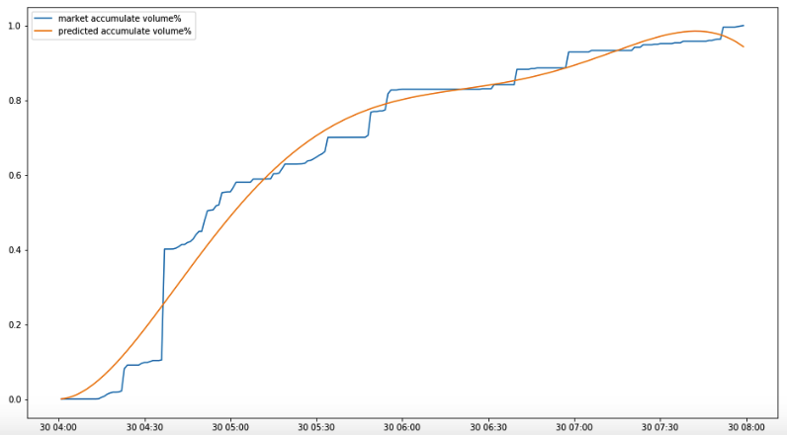
02
Specific methods and steps
Build the Model

Slide 18
02
Specific methods and steps
Build the Model

Slide 19
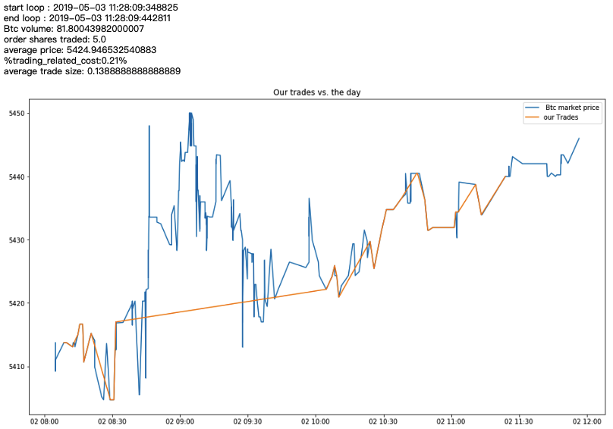
02
Specific methods and steps
Trade with Model

Slide 20
02
Specific methods and steps
2.Build EMA Margin Trade Strategy
Long at Long Signal, Short at Short Signal, Including Trade Cost
Calculate Exponential Moving Average(EMA)
Abnormal was mean +- 3*standard deviation
Calculate %Close vs EMA
Trade with Signal
Calculate EMA
Define Abnormal
Build Signal
Calculate pecentage of Close vs EMA
Long Signal at Negative Abnormal, Short Signal at Positive one

Slide 21
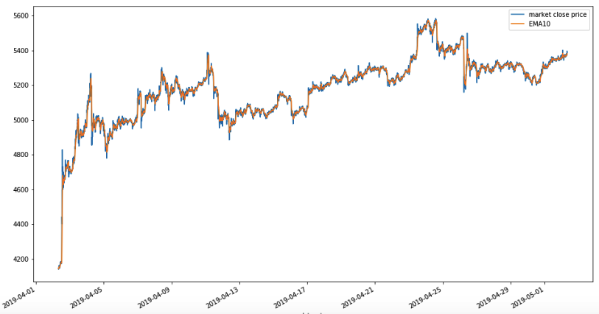
02
Specific methods and steps
Calculate EMA

Slide 22
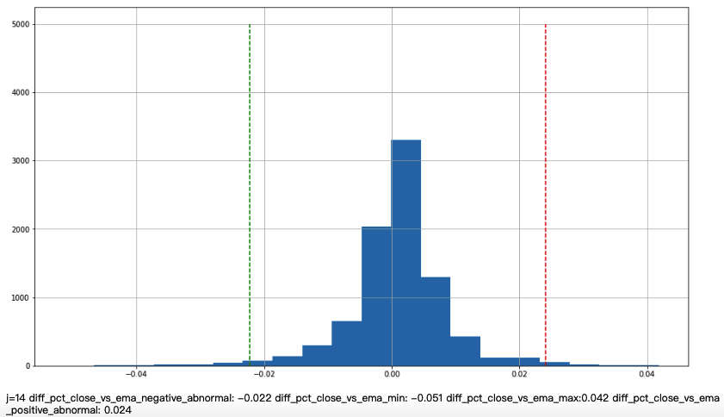
02
Specific methods and steps
Define Abnormal

Slide 23
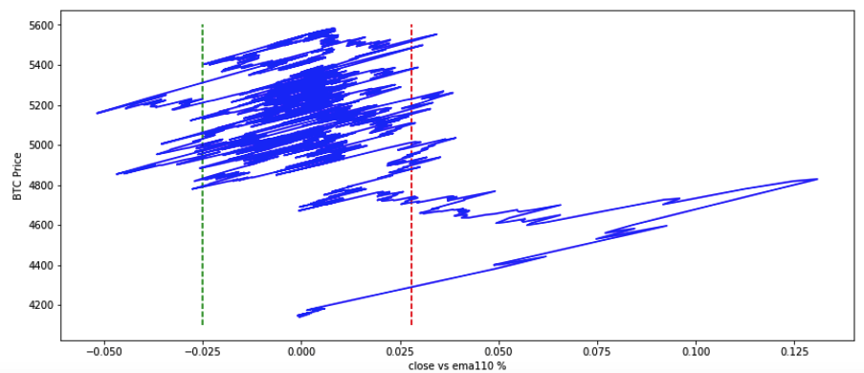
02
Specific methods and steps
Define Abnormal

Slide 24
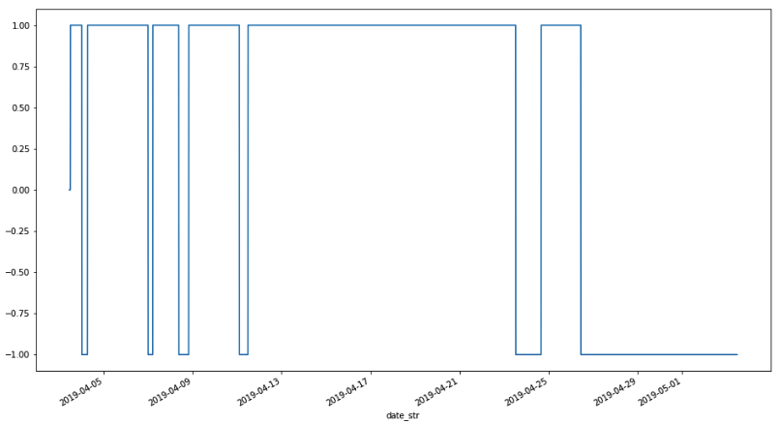
02
Specific methods and steps
Build Signal

Slide 25
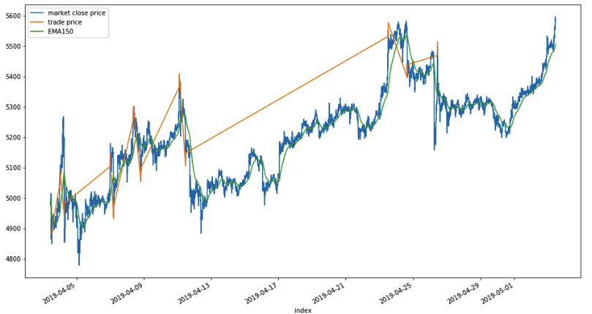
02
Specific methods and steps
Trade with Signal

Slide 26
02
Specific methods and steps
3.Optimize the Strategy
Select Multiple Span of EMA, Calculate Multiple EMAs
Calculate Sharpe and Winning Rate
Select Multiple Span
Execute Strategy with EMAs
Calculate Indicators
Find the Best EMA
Execute Strategy with different EMAs
Find the Best EMA with Max Sharpe and high Winning Rate

Slide 27
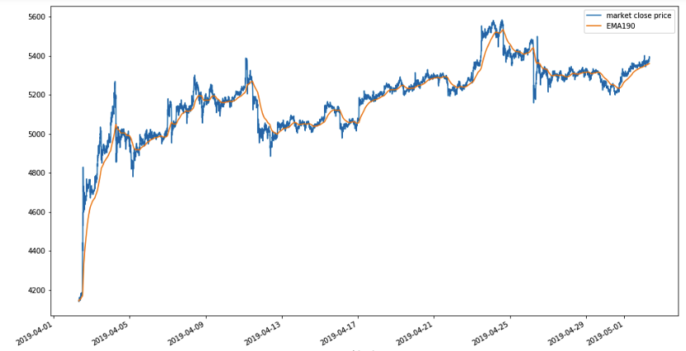
02
Specific methods and steps
Select Multiple Span

Slide 28

02
Specific methods and steps
Find the Best EMA

Slide 29
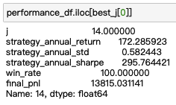
02
Specific methods and steps
Find the Best EMA

Slide 30
PART THREE
The Final Result

Slide 31
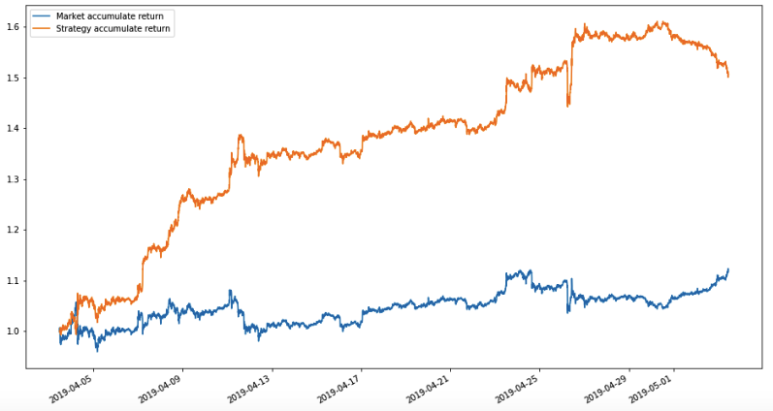
03
Final result
Accumulated Return Curve

Slide 32
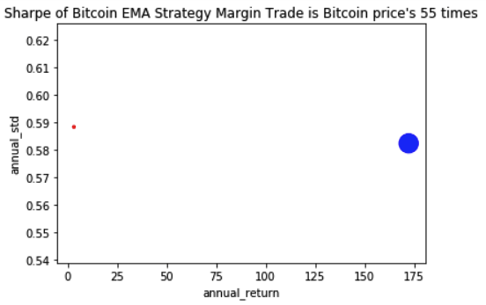
03
Final result
High Return Low risk

Slide 33
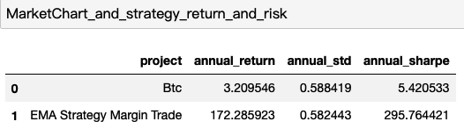
03
Final result
High Return Low risk

Slide 34
03
The final result
100
Best Span:150
75
Annual return:172
50
25
Winning Rate:100%
0

Slide 35
Thanks

